Slide 2
Contents

Slide 3
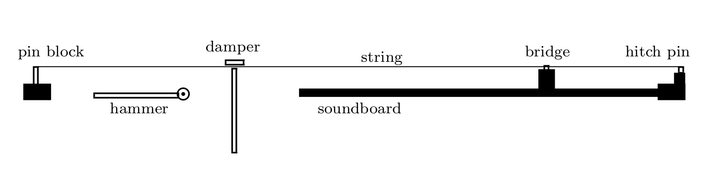
Setup
y
x
Saitis, Charalampos. Physical modelling of the piano: An investigation into the effect of string stiffness on the hammer-string interaction. Diss. Queen’s University Belfast, 2008.

Slide 4
Math
Equation of motion for the string:
Discretized equation:
Standard wave equation
String stiffness
Non-linear damping
Linear damping

Slide 5
Math
Hammer force:
Plan: Find motion of the hammer
Air friction term
Standard equation of motion

Slide 6
Math
Discretised equation:
Add hammer interaction to string equation:
Hammer force

Slide 7
Parameters
Many, many different parameters
String parameters
Hammer parameters
Numerical parameters

Slide 8
Animation

Slide 9
Frequency plots

Slide 10
Sound check (one note)

Slide 11
Live piano

Slide 12
Playing a song (sheet app)

